Slide 1

Exodus / Men’s Lent
Tips and Tricks

Slide 2
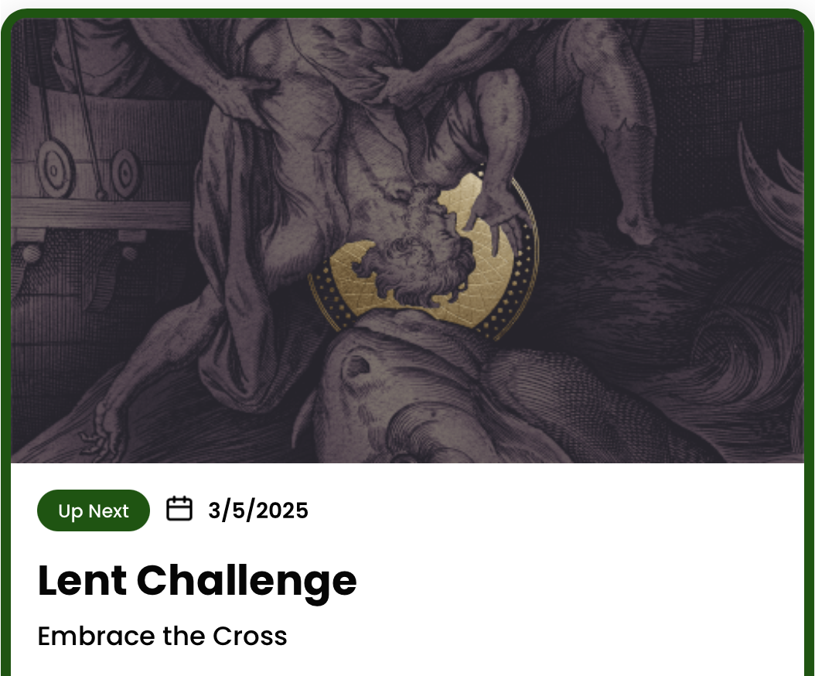
Outline
Disciplines
  What's different
Tips for success
  Participants
  Leaders
Inviting others

Slide 3
Disclaimer
I am just as broken as the next guy, if not more
The views below are a compilation of veterans’ experience. Not my own.

Slide 4
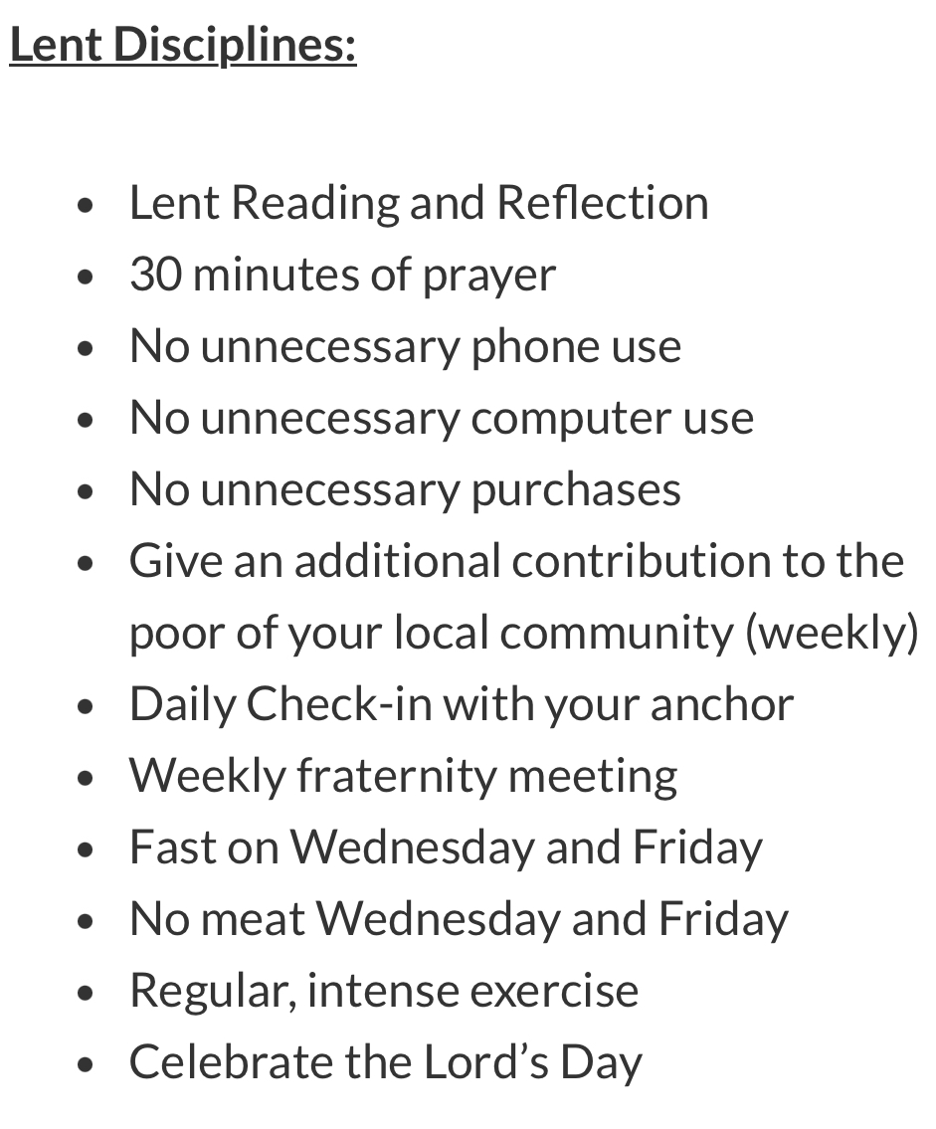
Disciplines
What's missing?
Only listen to music that lifts the soul to God.
Perform a nightly examine
Abstain from desserts and sweets.
No alcohol.
Abstain from eating between meals.
Abstain from soda or sweet drinks (white milk, black coffee, and black tea are permissible).
Abstain from games on devices.
Abstain from watching television, movies, or televised sports alone.
Get a full night’s sleep (at least seven hours is recommended).
Have cold showers

Slide 5
Suggestion
Discuss adding the other disciplines at the start of the Lent
Decide on these group by group
I believe men will want the challenge
Treat disciplines in the app as a minimum set

Slide 6


SUCCESS

Slide 7

Tips for success - 1
Focus on the Why?
Freedom FOR What
Notes:
Each of you should really ask yourself WHY you are doing this.
What is your focus. To be a better husband? Ok, what does that look like.
Then make sure you always check your reactions against that.

Slide 8
Tips for success - 1
Focus on the “Why?”
Disciplines are not an excuse for bad behaviour
Be mindful of impact on spouse / family
Be flexible especially for your spouse
Notes:
Each of you should really ask yourself WHY you are doing this.
What is your focus. To be a better husband? Ok, what does that look like.
Then make sure you always check your reactions against that.

Slide 9
Tips for success - 2
Talk to your spouse BEFORE you start
Share your why
Talk about the disciplines
Be gracious when mistakes happen (e.g. food)
Weekly meetings are not wife slagging sessions
Notes:
Share your why

Slide 10
Tips for success - 3
Focus on the Prayer
PRAYER IS EVERYTHING
Give God the 1st of your day / attention
God will bless the time left
Adoration is key
SILENCE TO HEAR GOD
Notes:
Share your why

Slide 11
Tips for success - 4
Schedule your priorities
Routine massively helps prayer
Helps you stick to disciplines
Night examine
Notes:
Share your why

Slide 12
Tips for success - 5
Make failing harder
Minimise reliance on will power
Delete apps / Hide remotes
Setup screen time protections
Leave phone away from bed
Don’t buy snacks / fizzy / alcohol
Plan ahead: books / podcasts / playlists
Notes:
Share your why

Slide 13
Tips for success - 6
Accountability
Give your Anchor and your family permission to hold you accountable
Own up when you fall
Notes:
Share your why

Slide 14
Tips for success - 7
Don’t despair
No one does it perfectly. We all fall
Own up, reach out and get up
Lean on God with struggles
Rome was not built in a day
Notes:
Share your why

Slide 15

Tips for success 9 – Leaders
Communication
  Whatsapp works well
  Choose catch up location for group meeting
Set fight club rules
Punctuality
Social gathering

Slide 16
Tips for success - 10
Seek the Sacraments
Strength from the Eucharist
Reconciliation
(recommend start and before Holy week)
Notes:
Share your why

Slide 17

Pitfalls
Don’t have a purpose
Don’t talk to your spouse
Pray whenever
Don’t plan or schedule
Don’t change your routines / triggers
Avoid responsibility
Block your anchor
Wallow in self pity
Don’t seek the sacraments

Slide 18
Inviting others – Common objections
COST
Time
Financial

Slide 19
Inviting others – Common objections
Time
Adoration time does not work for me
30-60 mins of prayer?
Isn't it selfish?

Slide 20
Inviting others – Common objections
Cost
Most people save money
Less than Media subscriptions
App not absolutely essential
It covers the whole year

Slide 21

Summary
Focus on what is important
Seek help
Spread the word

Slide 22
Insights
Lent 2025 – Exodus 40
Encouragement from Bishop Michael
Notes:
Mike to Introduce
Bishop Michael shares invitation to men

Slide 23
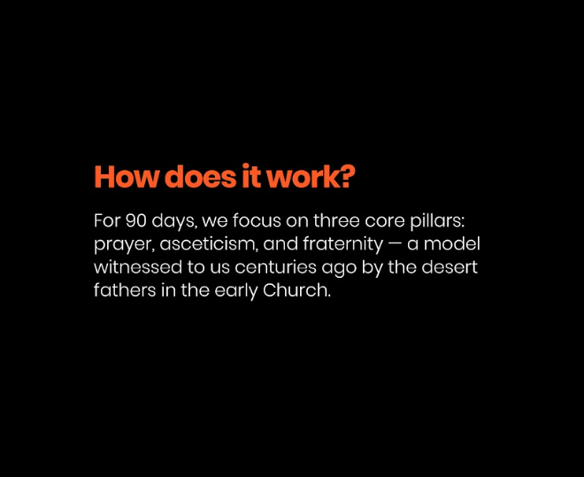
Overview
3 Core Pillars
Prayer
Asceticism
Fraternity
Notes:
Matt to discuss how it works

Slide 24
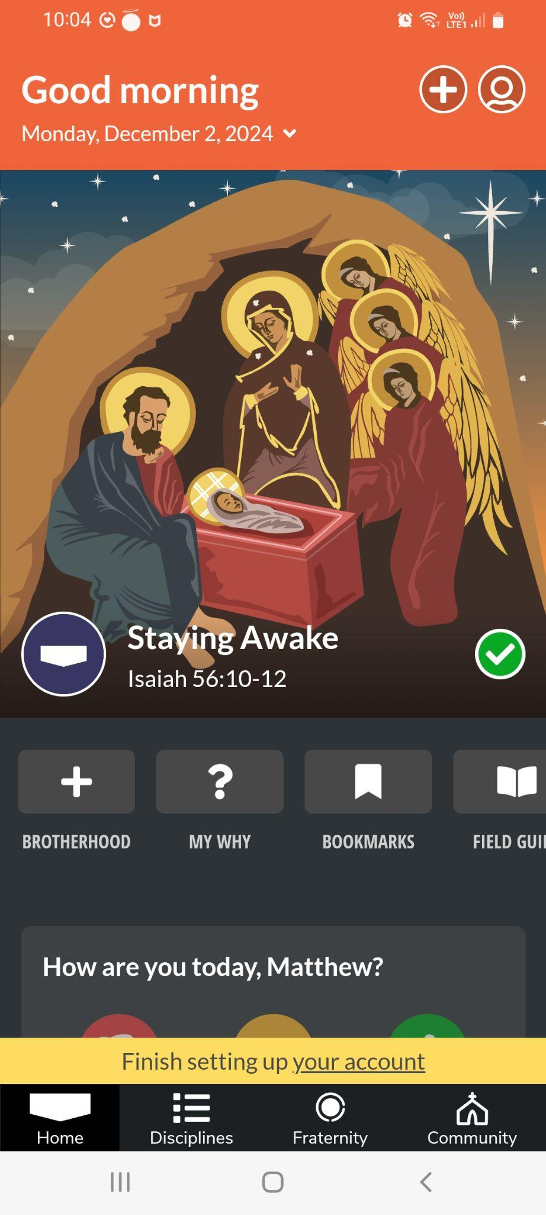
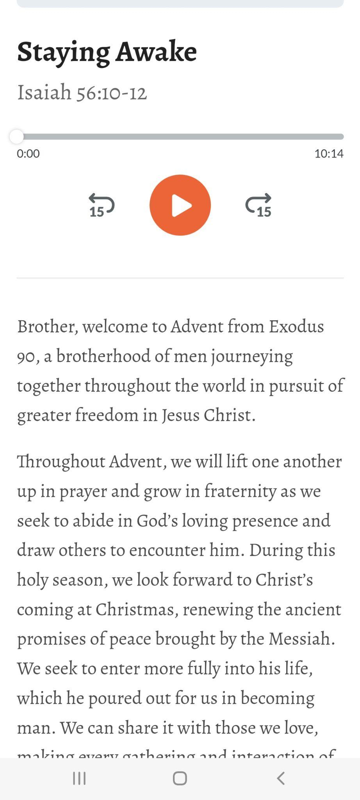
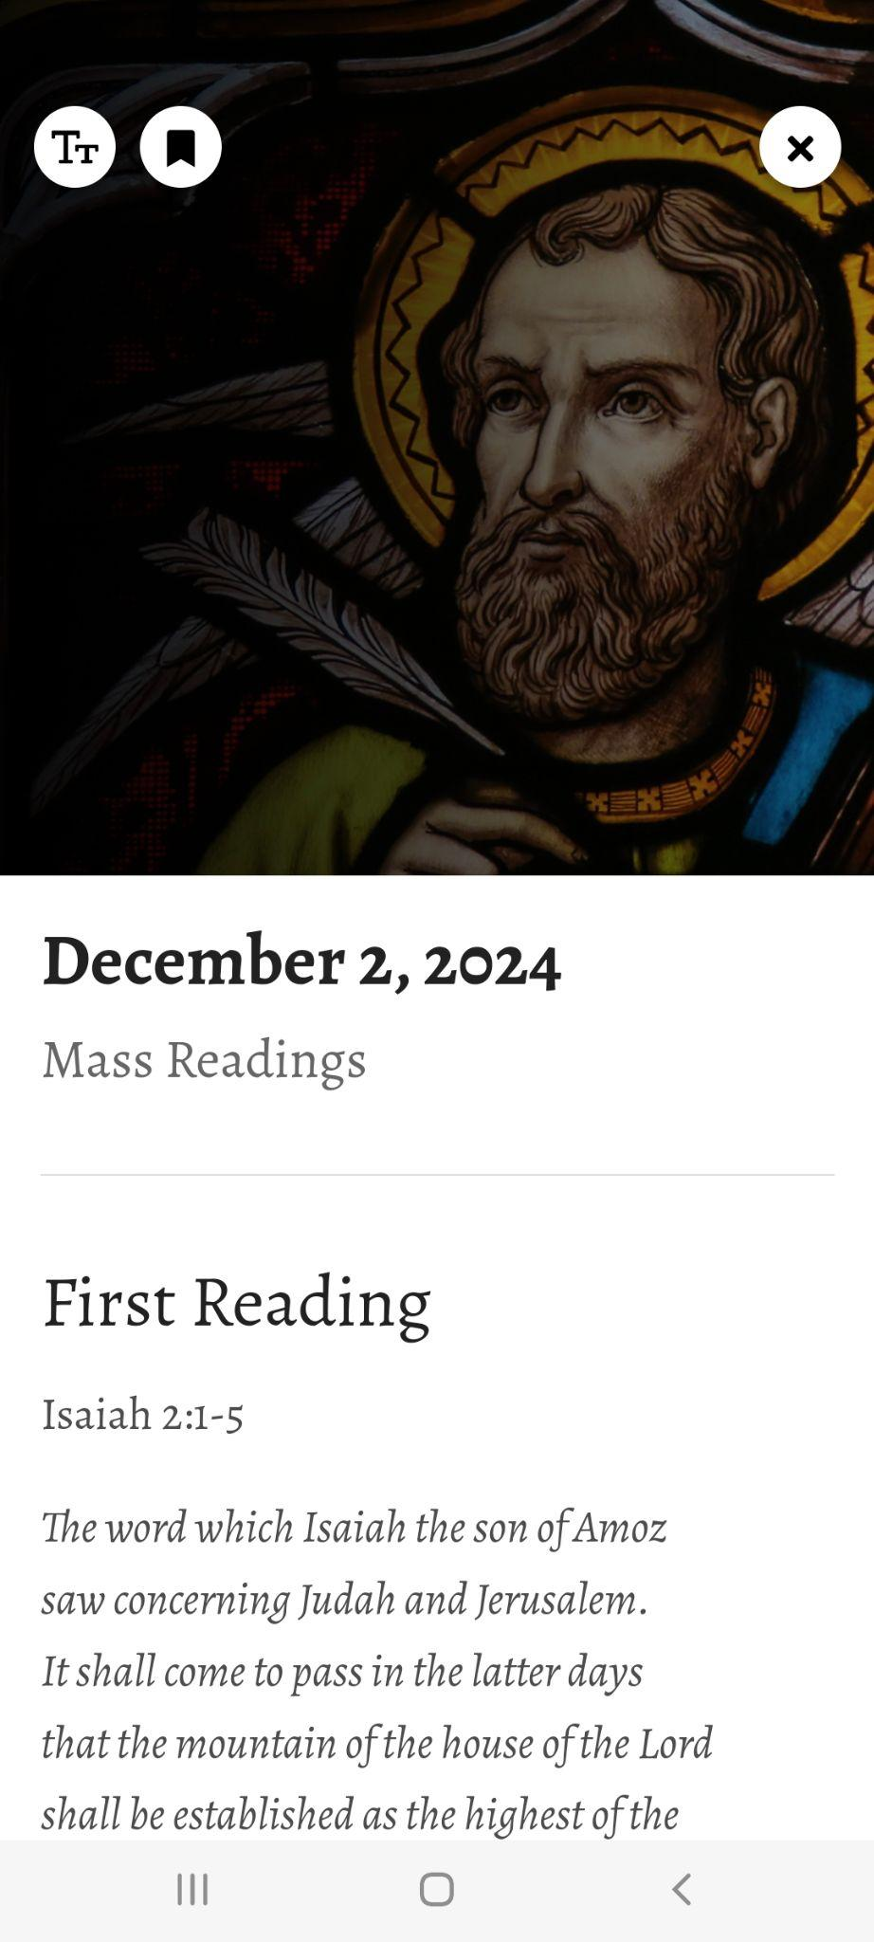
Prayer
Prayer is the key to Exodus
30 min silent prayer
Includes daily reflection, Mass readings & more
1 Holy hour a week
Nightly examine
Notes:
Matt to discuss the key components Prayer, Fraternity & Asceticism

Slide 25
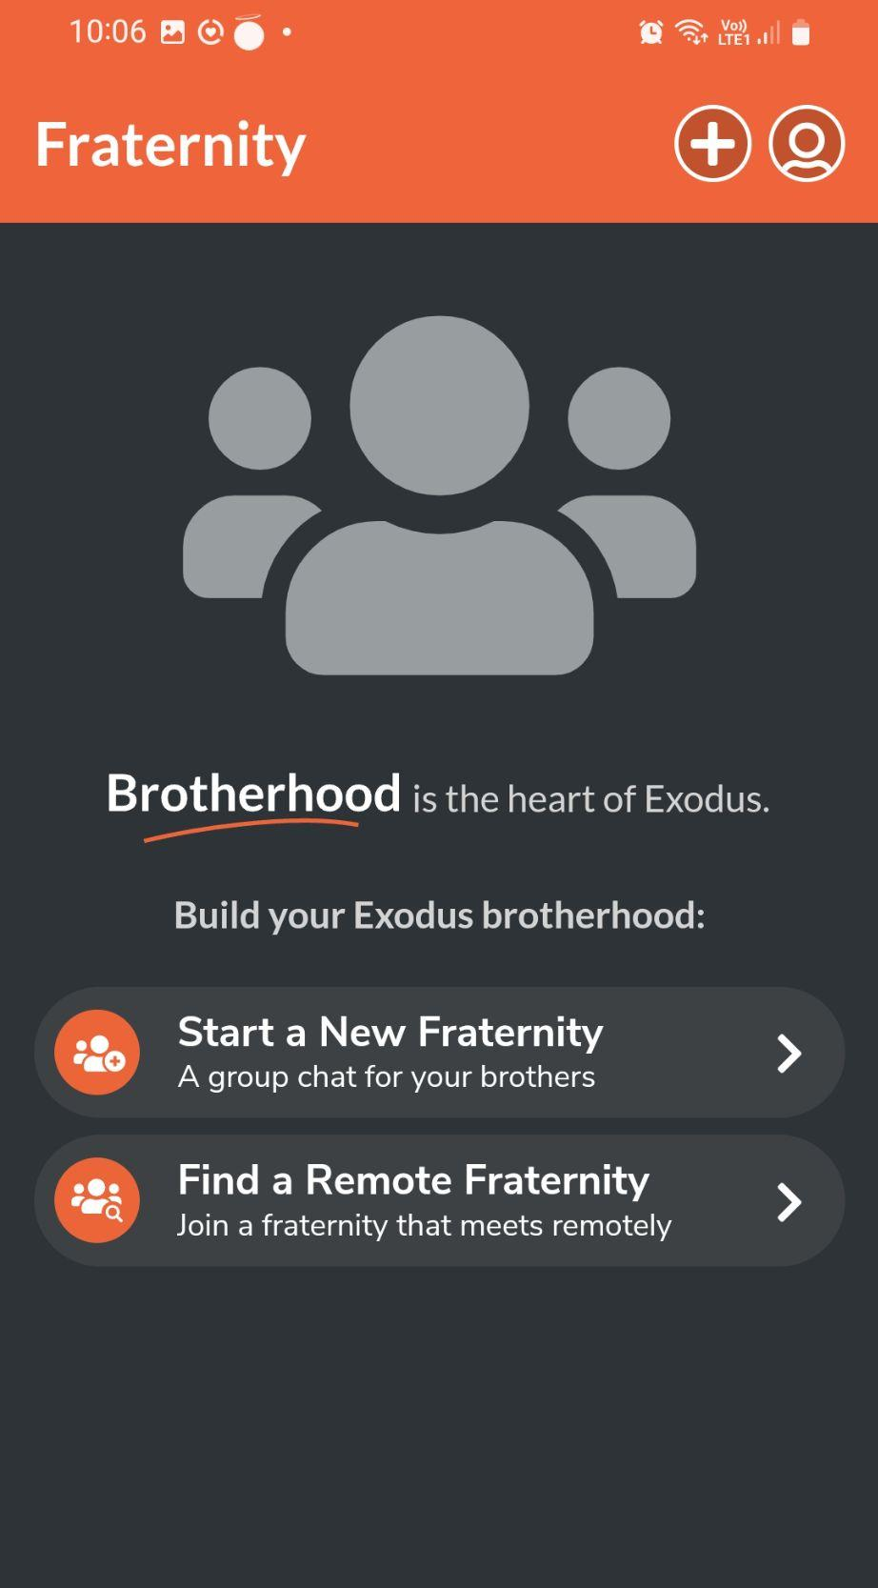
Fraternity
‘As Iron sharpens iron, so one man sharpens another’ Proverbs 27:17
Groups of 4 - 6 are ideal
Each man needs an anchor
Quick check in daily (text or call)
Meet for holy hour followed by Fraternity meeting one a week
Honesty, humility and trust is the key to real growth
Notes:
Matt to discuss the key components Prayer, Fraternity & Asceticism

Slide 26
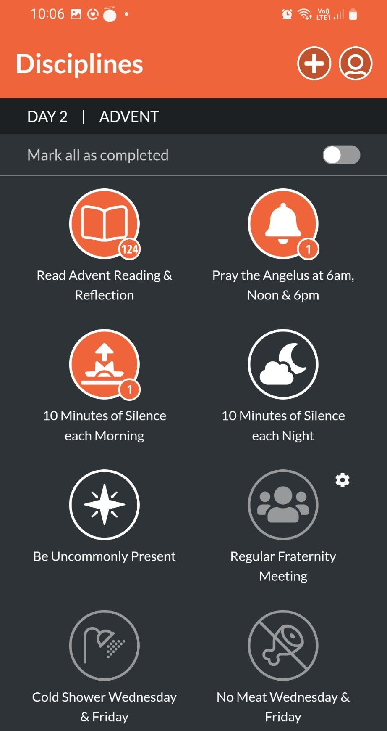
Disciplines
‘If any wish to come after me, let him deny himself and take up his cross daily and follow me’
These change for each season
Exodus 90 & 40
Cold showers
Fast from technology, snacking, news
No meat fridays
Notes:
Matt to discuss the key components Prayer, Fraternity & Asceticism

Slide 27

Testimony from Exodus men
Notes:
Mike to invite the Exodus group men (Rob, James, Matt, Danny) to share their testimony of the impact of Exodus 90 on their lives

Slide 28
Cost
Apple and Google Play - subscriptions $149.99 NZD per year.
Notes:
Mike to discuss the cost of the App

